Slide 1









Chongqing University of Technology
ATAI
Advanced Technique of Artificial Intelligence
Chongqing University of Technology
Reinforcement Learning-based N-ary Cross-Sentence Relation Extraction
AAAI_2020
Hongyang Song

Slide 2
Outline
Introduction
Method
  Sentence Distribution Estimator (SDE)
  Relation Extraction Model (RE)
Experience
Conclusion

Slide 3
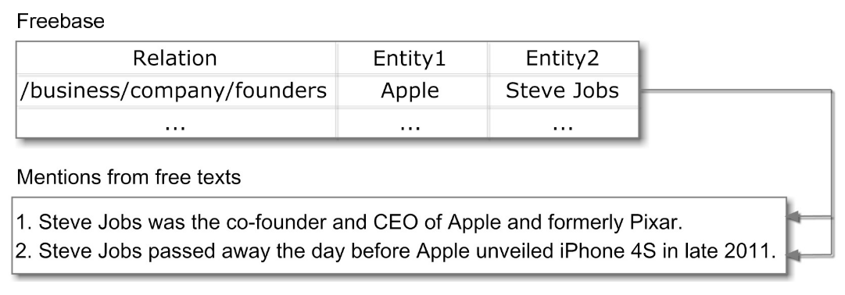
Introduction
Distant Supervision :
if two entities have a relation in a given knowledge base, all sentences that contain the two entities will mention that relation

Slide 4
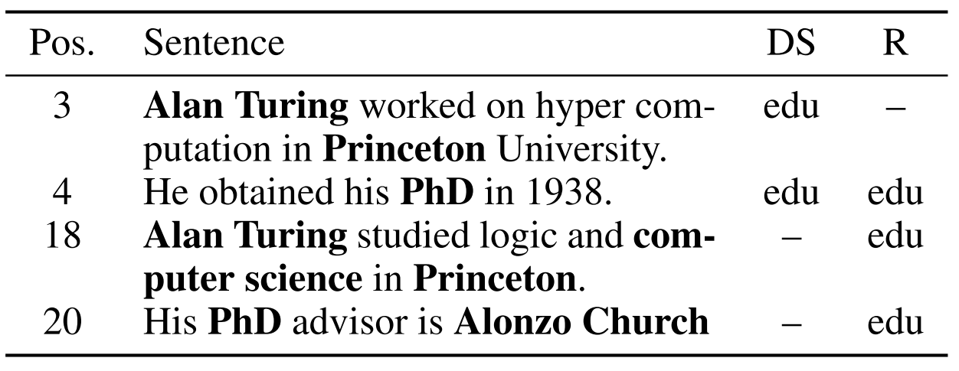
Introduction
Distant Supervision : consecutive sentences mentioning n entities describe the relation of these n entities
Fact: {Alan Turing, PhD, Princeton, computer science; relation: educate}
limitations: 1) introduce noisy labeled data
2) ignore non-consecutive sentences

Slide 5
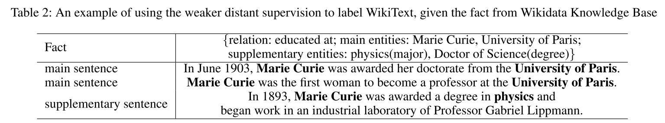
Introduction
Problem 2) :
the sentence that has at least one main entity or two supplementary entities is annotated with the relation of these entities
Problem 1) :
AAAI_2018_Reinforcement Learning for Relation Classification from Noisy Data
C++:
https://github.com/JuneFeng/RelationClassification-RL
python:
https://github.com/xuyanfu/TensorFlow_RLRE

Slide 6
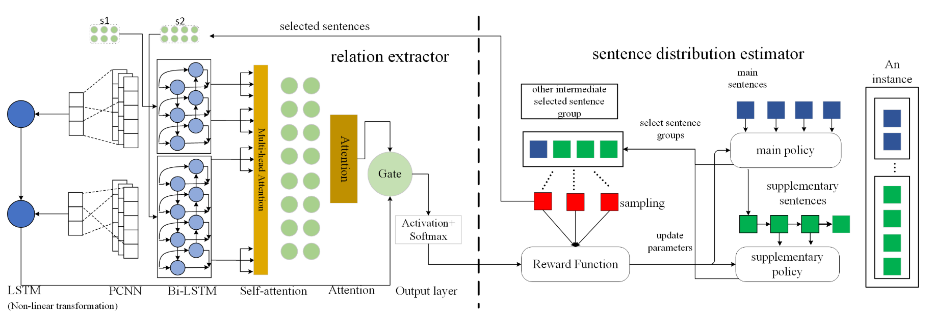
Method

Slide 7
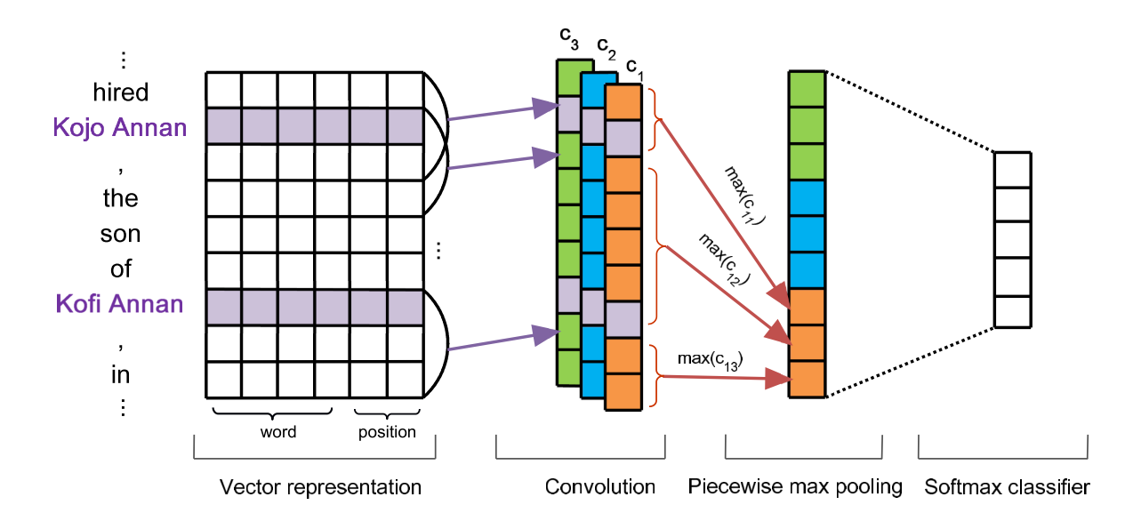

Method
PCNN:
ACL_2015_Distant supervision for relation extraction via piecewise convolutional neural networks
Position embedding:

Slide 8
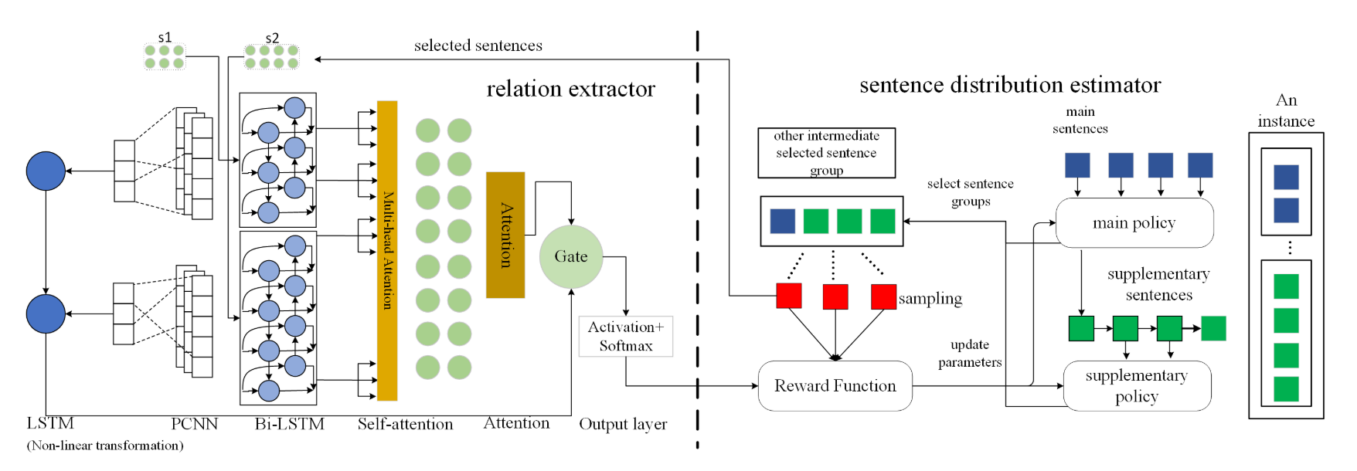
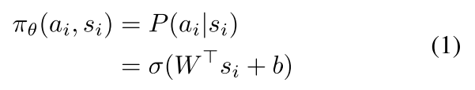

Method
Main Sentence-Level Policy:
State: PCNN(Piecewise Convolution Neural Network)
Action: $a_{i}$∈ {0, 1}
Policy:
Reward: classification accuracy of the RE model

Slide 9

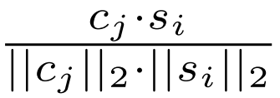
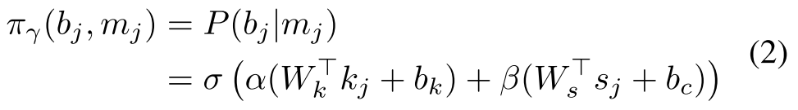


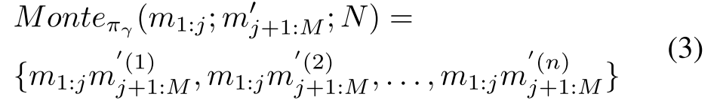
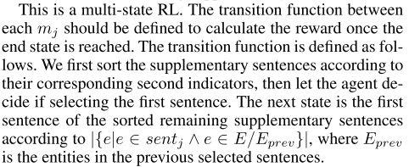
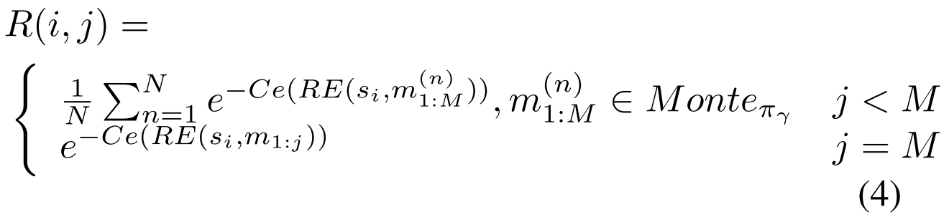


Method
Supplementary Sentence-Level Policy:
State: $m_{j}=\{c_{j}; e^{−d};e; \}$
Action: $b_{j}$∈ {0, 1}
Policy:
Reward:
疑问:

Slide 10
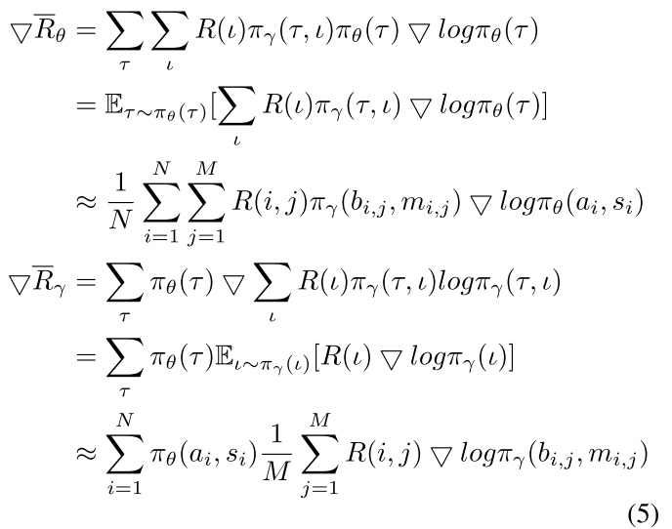
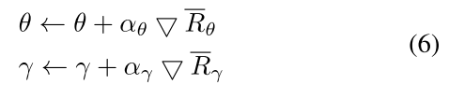
Method
Policy Gradient

Slide 11


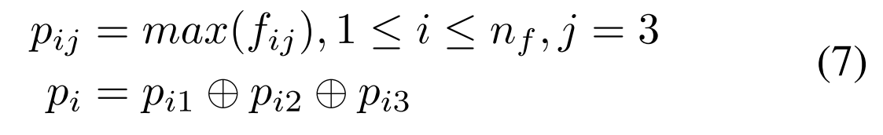


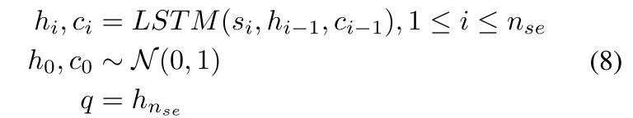
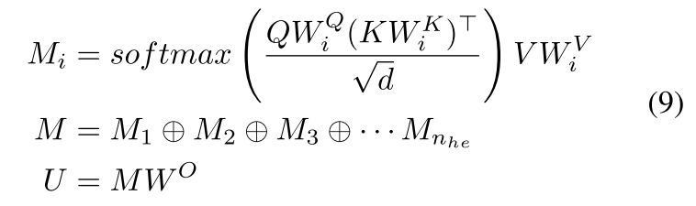
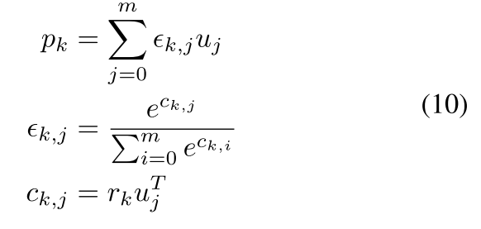
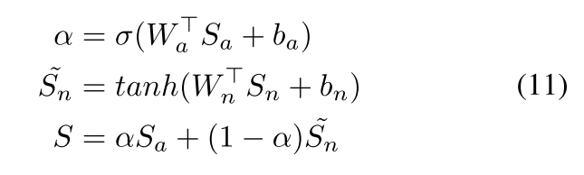





Method
Supplementary Sentence-Level Policy:
输入:
输出:
$p_{i}$第i个过滤器池化结果;$n_{f}$:卷积核数量
最终输出:
$n_{se}$:句子数量
$S_{a}$:attention的结果
$S_{n}$:LSTM的结果
$r_{k}$:k-th relation的科学系向量
$p_{k}$: relation $r_{k}$的attention结果
Notes:
Distant Supervision for Relation Extraction via Piecewise Convolutional Neural Networks

Slide 12
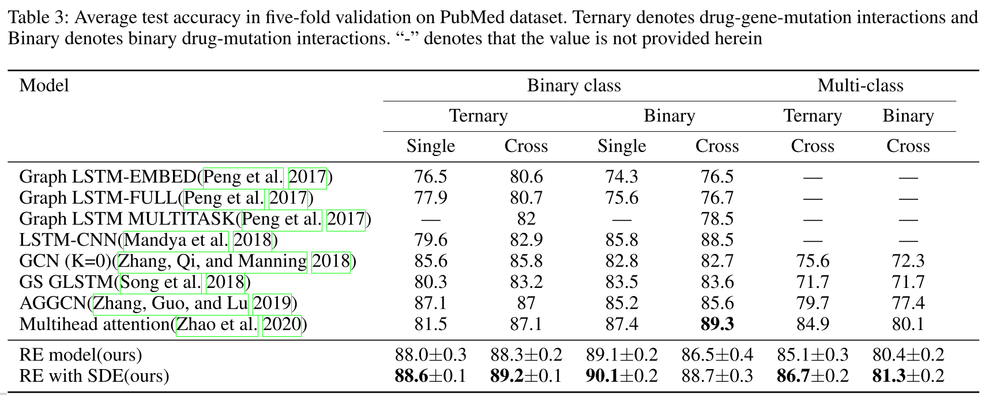
Experience
Dataset:
PubMed: create by Gene Drug Knowledge Database

Slide 13
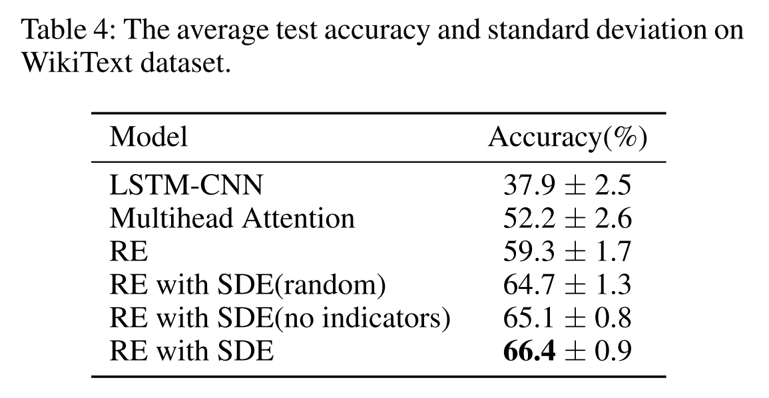
Experience
Dataset:
WikiText: Wikipedia webpages under the “People” category

Slide 14
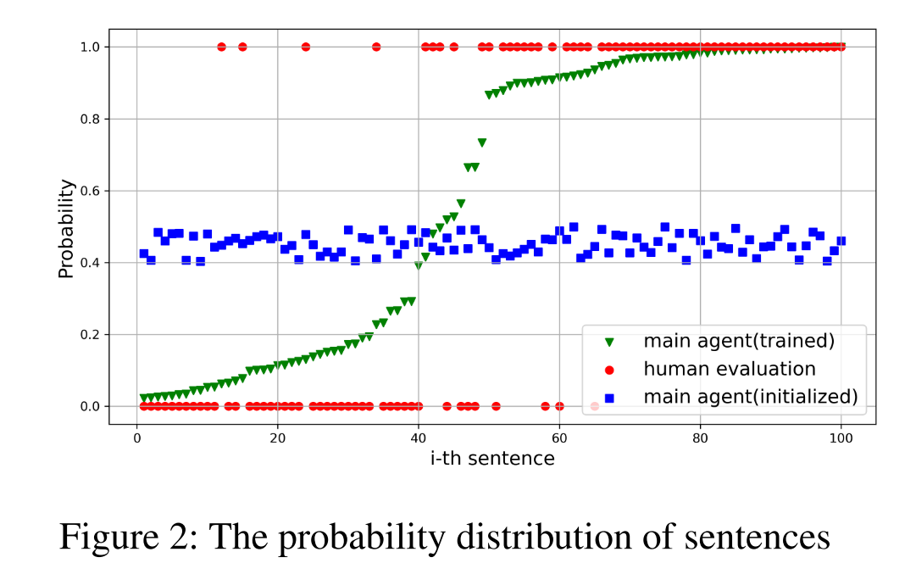
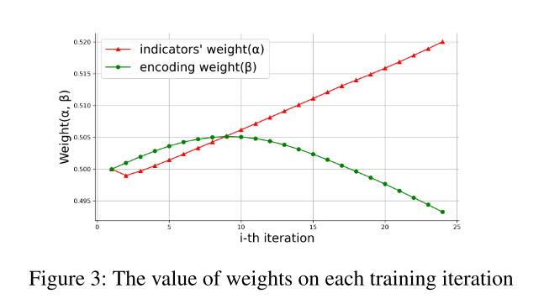
Experience

Slide 15
Thanks

